Slide 1
Artificial Intelligence
Knowledge Representation and Reasoning
Thanks to: Department of Computing Imperial College, London

Slide 2
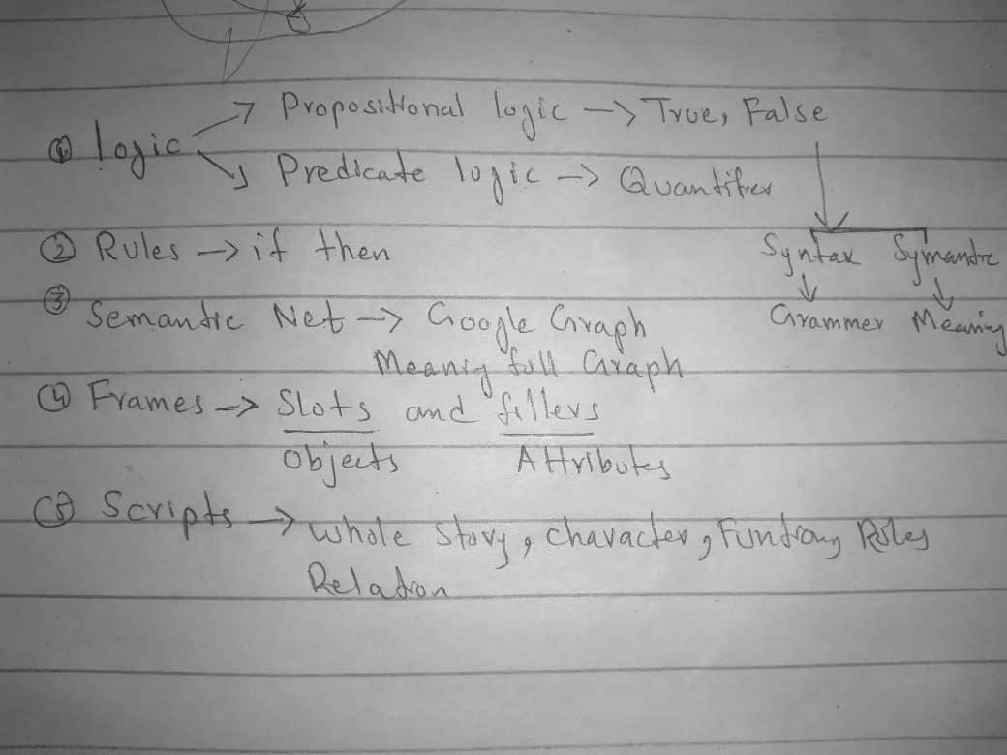

Slide 3
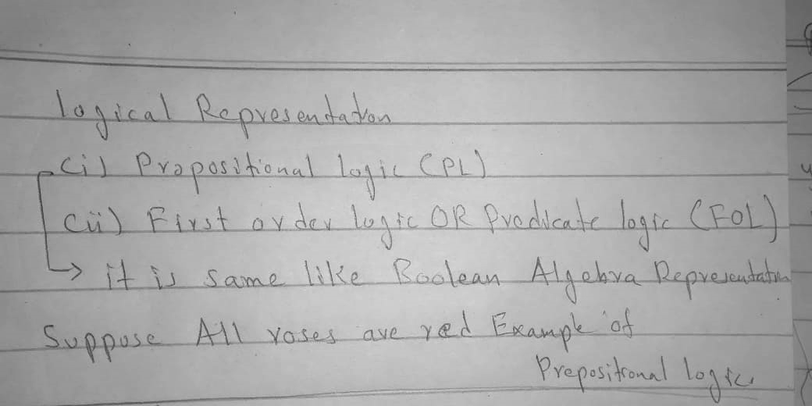

Slide 4
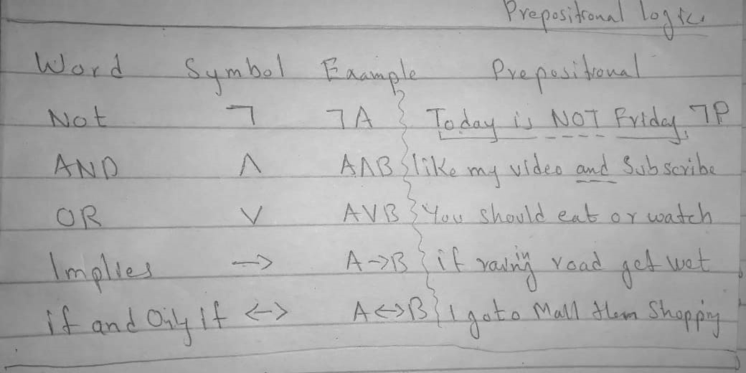

Slide 5
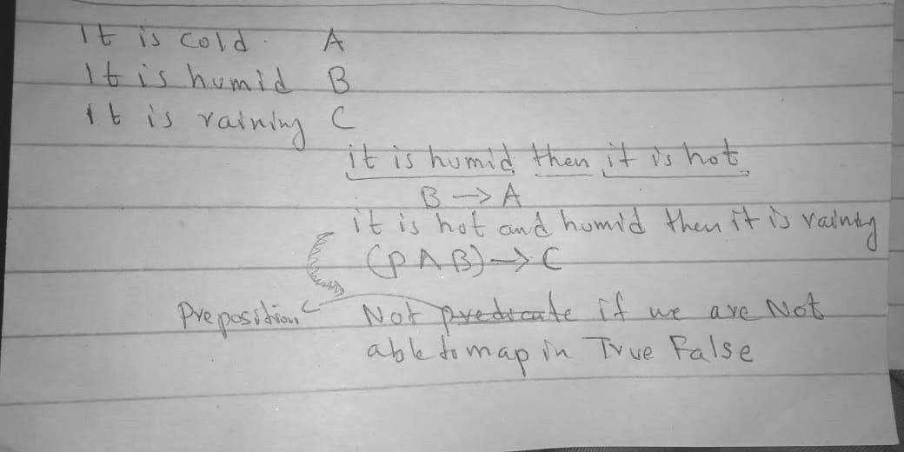

Slide 6
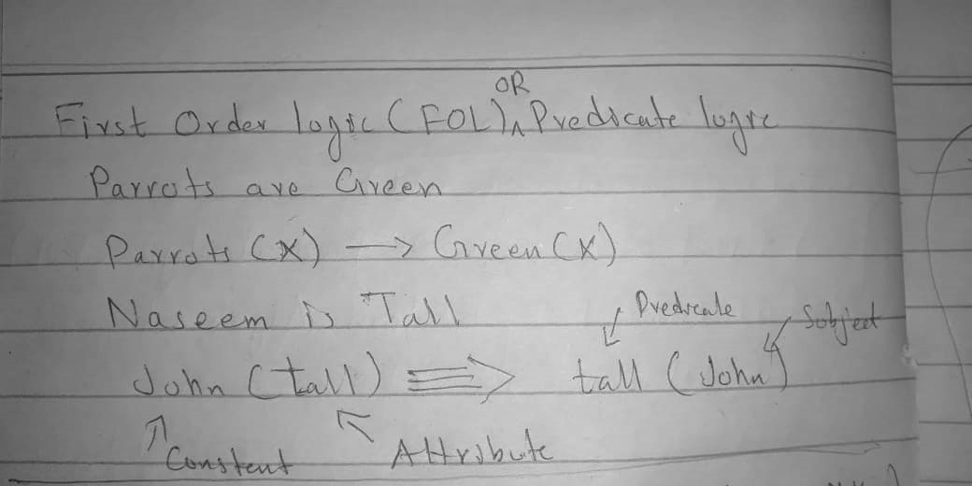

Slide 8
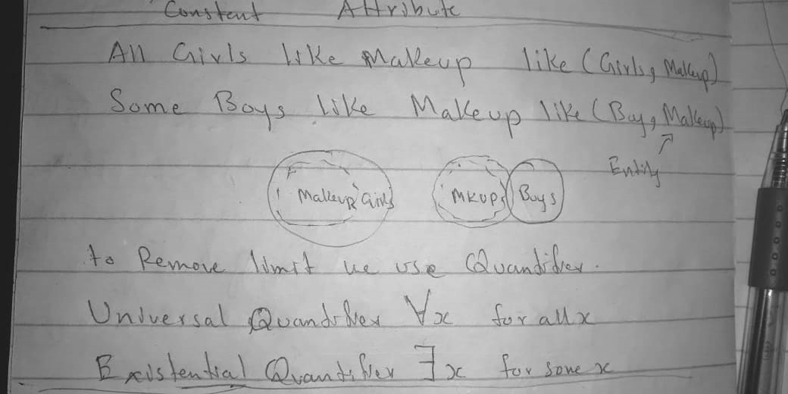

Slide 9
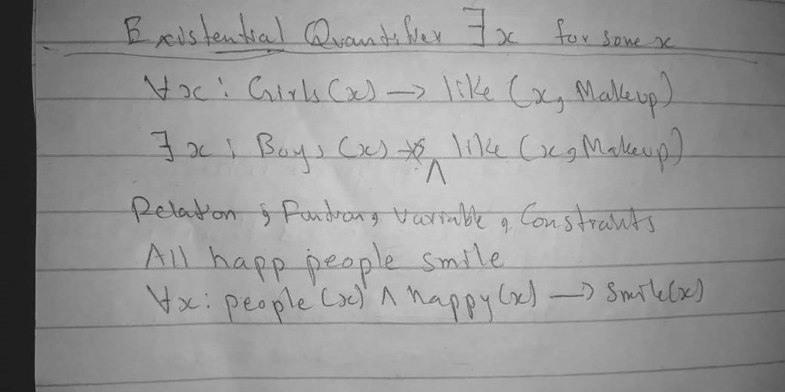

Slide 10
Representation
AI agents deal with knowledge (data)
  Facts (believe & observe knowledge)
  Procedures (how to knowledge)
  Meaning (relate & define knowledge)
Right representation is crucial
  Early realisation in AI
  Wrong choice can lead to project failure
  Active research area

Slide 11
Choosing a Representation
For certain problem solving techniques
  ‘Best’ representation already known
  Often a requirement of the technique
  Or a requirement of the programming language (e.g. Prolog)
Examples
  First order theorem proving… first order logic
  Inductive logic programming… logic programs
  Neural networks learning… neural networks
Some general representation schemes
  Suitable for many different (and new) AI applications

Slide 12
Some General Representations
Logical Representations
Production Rules
Semantic Networks
  Conceptual graphs, frames
Description Logics (Scripts)

Slide 13
What is a Logic?
A language with concrete rules
  No ambiguity in representation (may be other errors!)
  Allows unambiguous communication and processing
  Very unlike natural languages e.g. English
Many ways to translate between languages
  A statement can be represented in different logics
  And perhaps differently in same logic
Expressiveness of a logic
  How much can we say in this language?
Not to be confused with logical reasoning
  Logics are languages, reasoning is a process (may use logic)

Slide 14
Syntax and Semantics
Syntax
  Rules for constructing legal sentences in the logic
  Which symbols we can use (English: letters, punctuation)
  How we are allowed to combine symbols
Semantics
  How we interpret (read) sentences in the logic
  Assigns a meaning to each sentence
Example: “All lecturers are seven foot tall”
  A valid sentence (syntax)
  And we can understand the meaning (semantics)
  This sentence happens to be false (there is a counterexample)

Slide 15

Propositional Logic
Syntax
  Propositions, e.g. “it is wet”
  Connectives: and, or, not, implies, iff (equivalent)
  Brackets, T (true) and F (false)
Semantics (Classical AKA Boolean)
  Define how connectives affect truth
    “P and Q” is true if and only if P is true and Q is true
  Use truth tables to work out the truth of statements

